Slide 1
DynaSLAM：Tracking Mapping and Inpainting in Dynamic Scenes
贾彦鹏
Class ：0717
Group：1
Data ：2023.10.23

Slide 2
Outline
一、Introduction
二、Method
三、Experiments
四、Conclusion
五、Video

Slide 3
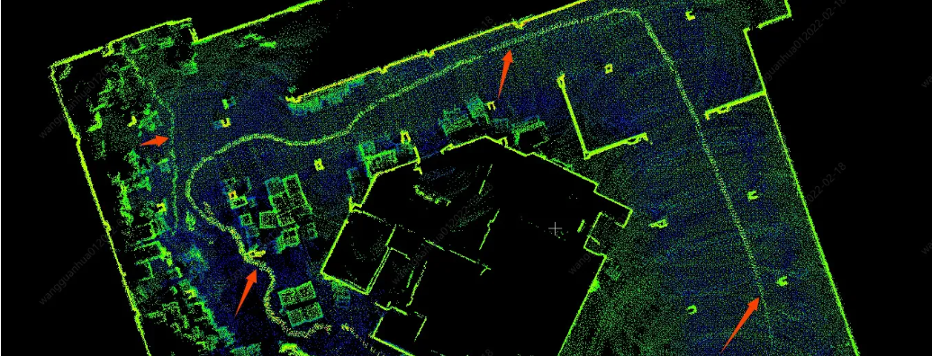
Introduction
通常假定：静态且刚体环境。
动态物体：作为异常值处理
解决长期(long-term)定位与导航
在视觉SLAM中要完成这几个挑战：
1. 防止使用动态物体tracking；防止将动态物体mapping到地图中
2. 如何完成被移动物体暂时遮挡的3D地图部分
Main contributions:
·修改ORB-SLAM2的前端
·结合多视图几何模型和CNN来检测动态物体
·在将它们从图像中移除后，用正确的场景信息重新绘制被遮挡的背景(√)
Notes:
Abeba Birhane is an Ethiopian-born cognitive scientist who works at the intersection of complex adaptive systems, machine learning, algorithmic bias, and critical race studies. In 2015, she completed her Master of Science in Cognitive Science and, in 2021, her Ph.D. at the Complex Software Lab in the School of Computer Science at University College Dublin.She has been recognized by VentureBeat as a top innovator in computer vision and named as one of the 100 most influential persons in AI 2023 by TIME magazine.She blogs regularly about embodied cognition and the enactive approach to congnitive science.
You can see this artical in this website.

Slide 4
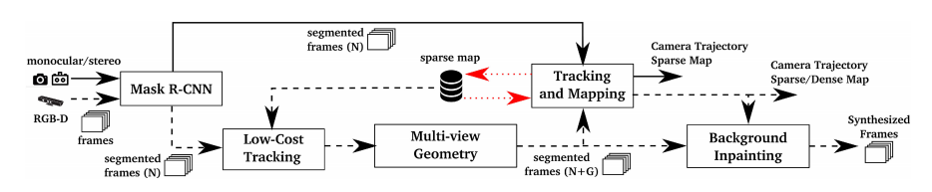
Method
Mask R-CNN
·Input：RGB image
·Off-line traning and obtain a list，如果需要其他类，在MS COCO上训练的网络可以用新的训练数据进行微调。
Input：m×n×3 RGB image
Output：m×n×l Matrix，where l is the number of objects
对于每个输出通道i∈l，得到一个二进制掩码。通过将所有通道合并为一个通道，可以得到在一个场景图像中出现的所有动态物体的分割。
Example：
people=[0,0,0,1,0,0]
cat=[0,1,0,0,0,0]
output=[0,1,0,1,0,0]
Notes:
Descartes was a French philosopher, scientist, and mathematician, widely considered a seminal figure in the emergence of modern philosophy and science.
Descartes has often been called the father of modern philosophy, and is largely seen as responsible for the increased attention given to epistemology in the 17th century.He laid the foundation for 17th-century continental rationalism, later advocated by Spinoza and Leibniz, and was later opposed by the empiricist school of thought consisting of Hobbes, Locke, Berkeley, and Hume.
Descartes' influence in mathematics is equally apparent; the Cartesian coordinate system was named after him. He is credited as the father of analytic geometry—used in the discovery of infinitesimal calculus and analysis. Descartes was also one of the key figures in the Scientific Revolution.

Slide 5
Method
Low-Cost Tracking
主要目的：提供一个粗略的相机位姿，用于后续的多视图几何(Multi-view Geometry)模块
·在对潜在的动态内容进行分割后，使用图像的静态部分跟踪摄像机的姿态
·由于边缘轮廓通常为高梯度区域，容易出现跳变的点特征，所以没有考虑这些区域的特征。
·比ORB-SLAM2中的跟踪更简单，因此计算量更轻。
·最小化重投影误差以优化相机姿态。
Notes:
Descartes was a French philosopher, scientist, and mathematician, widely considered a seminal figure in the emergence of modern philosophy and science.
Descartes has often been called the father of modern philosophy, and is largely seen as responsible for the increased attention given to epistemology in the 17th century.He laid the foundation for 17th-century continental rationalism, later advocated by Spinoza and Leibniz, and was later opposed by the empiricist school of thought consisting of Hobbes, Locke, Berkeley, and Hume.
Descartes' influence in mathematics is equally apparent; the Cartesian coordinate system was named after him. He is credited as the father of analytic geometry—used in the discovery of infinitesimal calculus and analysis. Descartes was also one of the key figures in the Scientific Revolution.

Slide 6
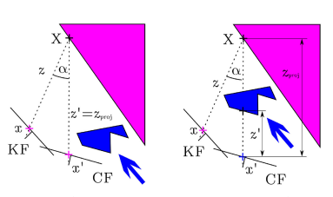
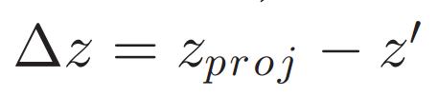
Method
Multi-view Geometry
与Mask R-CNN互补，并解决半静态物体
对应特征点x,x`之间的视差角α>30°？ 有可能被遮挡
Inspire by experiment-TUM
进一步完善：当前帧中剩余关键点的深度z`
Notes:
Descartes was a French philosopher, scientist, and mathematician, widely considered a seminal figure in the emergence of modern philosophy and science.
Descartes has often been called the father of modern philosophy, and is largely seen as responsible for the increased attention given to epistemology in the 17th century.He laid the foundation for 17th-century continental rationalism, later advocated by Spinoza and Leibniz, and was later opposed by the empiricist school of thought consisting of Hobbes, Locke, Berkeley, and Hume.
Descartes' influence in mathematics is equally apparent; the Cartesian coordinate system was named after him. He is credited as the father of analytic geometry—used in the discovery of infinitesimal calculus and analysis. Descartes was also one of the key figures in the Scientific Revolution.

Slide 7
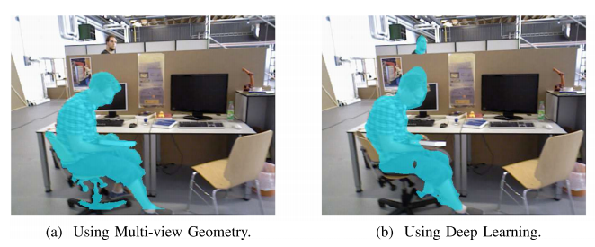
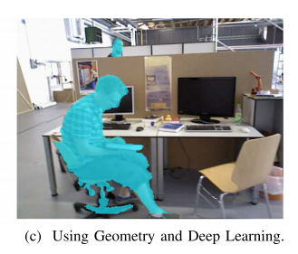
Method
Multi-view Geometry
为了对所有属于动态对象的像素进行分类，在深度图像中围绕动态像素生长区域(理解为扩充)。
两个动态物体检测模块进行互补融合：
如果用两种方法都检测到一个对象，则分割掩码应该是几何方法的掩码。如果一个对象只被基于学习的方法检测到，分割掩码也应该包含这个信息。
Notes:
Descartes was a French philosopher, scientist, and mathematician, widely considered a seminal figure in the emergence of modern philosophy and science.
Descartes has often been called the father of modern philosophy, and is largely seen as responsible for the increased attention given to epistemology in the 17th century.He laid the foundation for 17th-century continental rationalism, later advocated by Spinoza and Leibniz, and was later opposed by the empiricist school of thought consisting of Hobbes, Locke, Berkeley, and Hume.
Descartes' influence in mathematics is equally apparent; the Cartesian coordinate system was named after him. He is credited as the father of analytic geometry—used in the discovery of infinitesimal calculus and analysis. Descartes was also one of the key figures in the Scientific Revolution.

Slide 8
Method
Mask R-CNN
·Input：RGB image, Deep image, their masks, and ORB fetures in static regions
·Out：Sparse map, Camera Trajectory and Dense map
由于线段轮廓是高梯度区域，因此必须移除落在该交点上的关键点。
Notes:
Descartes was a French philosopher, scientist, and mathematician, widely considered a seminal figure in the emergence of modern philosophy and science.
Descartes has often been called the father of modern philosophy, and is largely seen as responsible for the increased attention given to epistemology in the 17th century.He laid the foundation for 17th-century continental rationalism, later advocated by Spinoza and Leibniz, and was later opposed by the empiricist school of thought consisting of Hobbes, Locke, Berkeley, and Hume.
Descartes' influence in mathematics is equally apparent; the Cartesian coordinate system was named after him. He is credited as the father of analytic geometry—used in the discovery of infinitesimal calculus and analysis. Descartes was also one of the key figures in the Scientific Revolution.

Slide 9
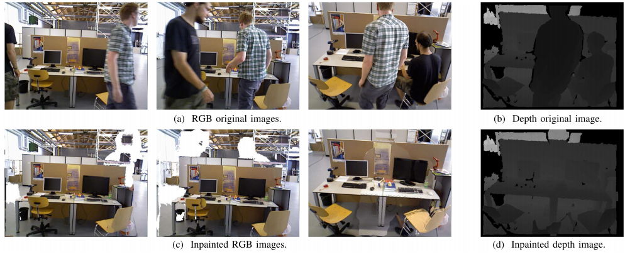
Method
Background Inpainting
对于每一个被移除的动态对象，应该用之前视图中的静态信息重新绘制被遮挡的背景。
将所有之前关键帧的RGB和深度信息投射到当前帧的动态区域。
空白：没有对应、还未出现、信息缺失
解决：MLP
Application：虚拟现实、增强现实、相机跟踪、重新定位
Notes:
Descartes was a French philosopher, scientist, and mathematician, widely considered a seminal figure in the emergence of modern philosophy and science.
Descartes has often been called the father of modern philosophy, and is largely seen as responsible for the increased attention given to epistemology in the 17th century.He laid the foundation for 17th-century continental rationalism, later advocated by Spinoza and Leibniz, and was later opposed by the empiricist school of thought consisting of Hobbes, Locke, Berkeley, and Hume.
Descartes' influence in mathematics is equally apparent; the Cartesian coordinate system was named after him. He is credited as the father of analytic geometry—used in the discovery of infinitesimal calculus and analysis. Descartes was also one of the key figures in the Scientific Revolution.

Slide 10
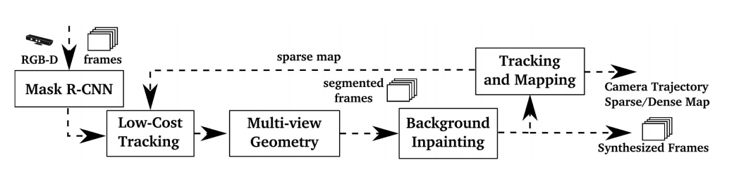
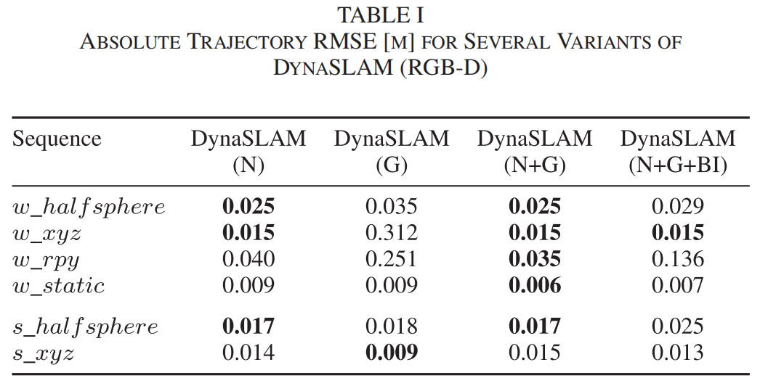
Experiments
Experiment Setup：
在TUM RGB-D数据集和KITTI数据集中评估了，并在动态环境中与其他最先进的SLAM系统进行了比较。每个实验做10次，取中位数。
TUM Database
这个实验的动机是，如果将动态区域与静态内容进行修补，则系统可以使用修补后的图像作为静态假设下的SLAM系统。在此方案中，ORB特征提取算法同时在帧的真实区域和重建区域工作，找到与先前处理的关键帧的关键点匹配。
Notes:
Descartes was a French philosopher, scientist, and mathematician, widely considered a seminal figure in the emergence of modern philosophy and science.
Descartes has often been called the father of modern philosophy, and is largely seen as responsible for the increased attention given to epistemology in the 17th century.He laid the foundation for 17th-century continental rationalism, later advocated by Spinoza and Leibniz, and was later opposed by the empiricist school of thought consisting of Hobbes, Locke, Berkeley, and Hume.
Descartes' influence in mathematics is equally apparent; the Cartesian coordinate system was named after him. He is credited as the father of analytic geometry—used in the discovery of infinitesimal calculus and analysis. Descartes was also one of the key figures in the Scientific Revolution.

Slide 11
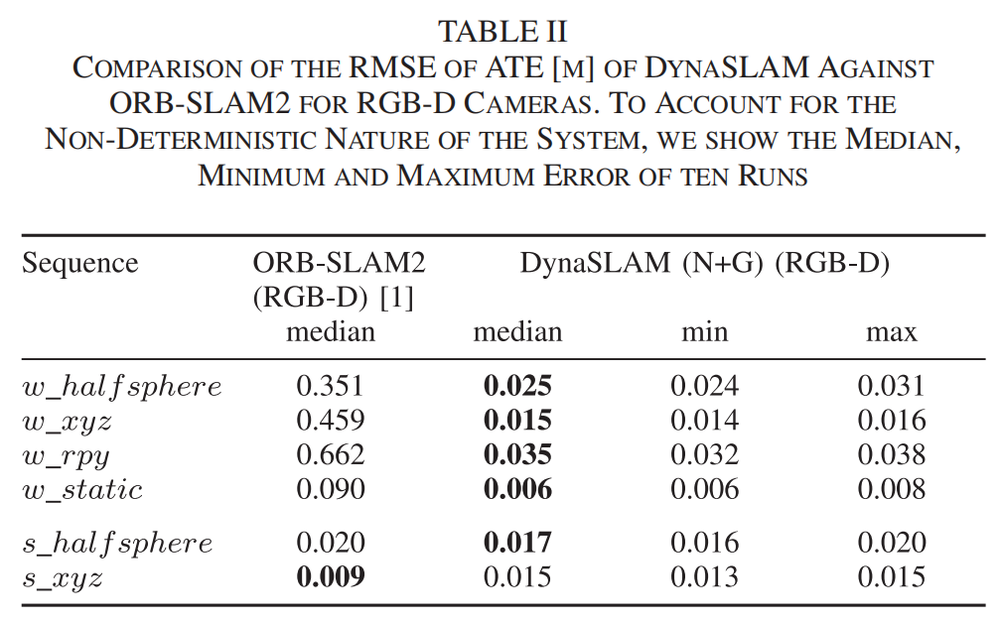
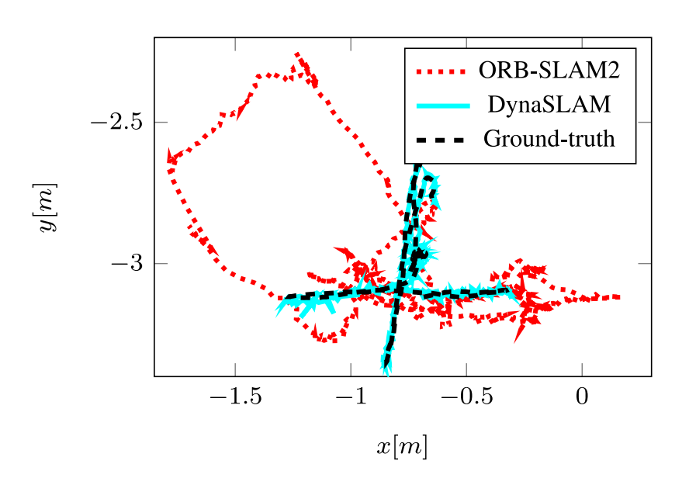
Experiments
TUM Database compare with ORB-SLAM2
所提出的方法在高动态场景(walking)中优于ORBSLAM2，在静态场景中达到与原始ORB-SLAM2系统相似的误差。在低动态场景(sitting)的情况下，跟踪结果略差，因为跟踪的关键点发现自己比那些属于动态对象的关键点更远。
Notes:
Descartes was a French philosopher, scientist, and mathematician, widely considered a seminal figure in the emergence of modern philosophy and science.
Descartes has often been called the father of modern philosophy, and is largely seen as responsible for the increased attention given to epistemology in the 17th century.He laid the foundation for 17th-century continental rationalism, later advocated by Spinoza and Leibniz, and was later opposed by the empiricist school of thought consisting of Hobbes, Locke, Berkeley, and Hume.
Descartes' influence in mathematics is equally apparent; the Cartesian coordinate system was named after him. He is credited as the father of analytic geometry—used in the discovery of infinitesimal calculus and analysis. Descartes was also one of the key figures in the Scientific Revolution.

Slide 12
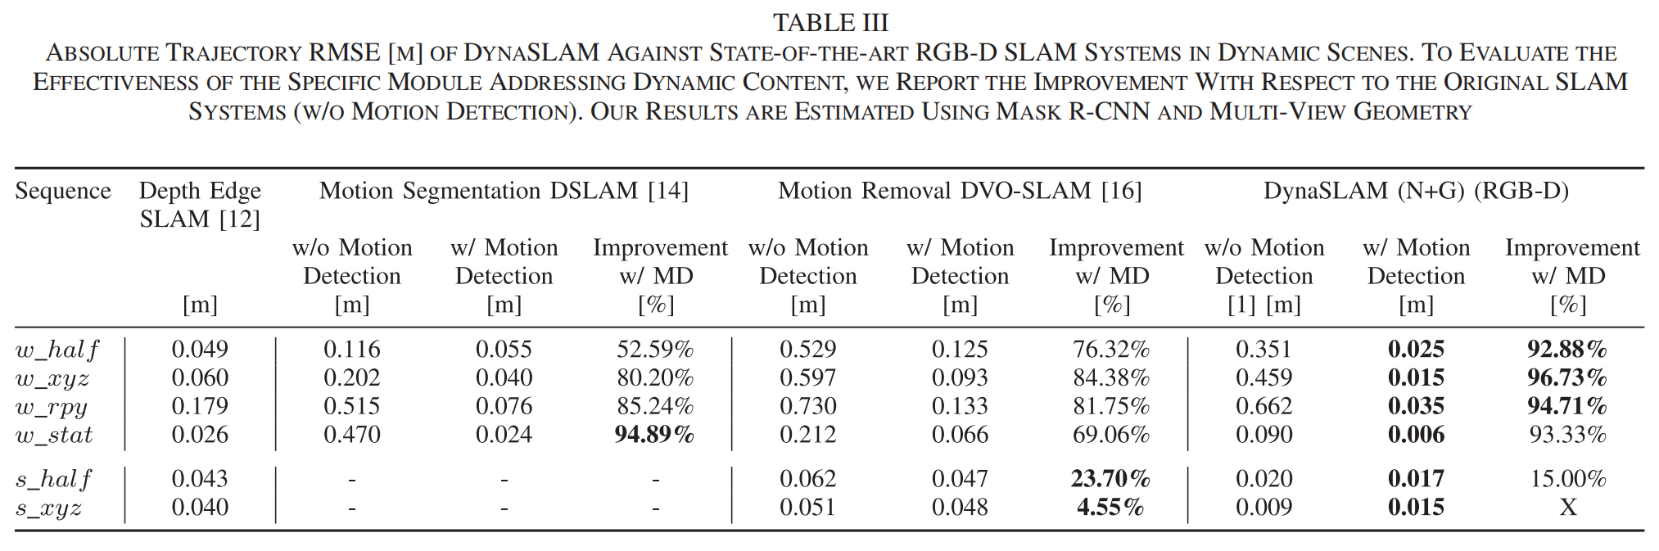
Experiments
Compare with SOTA
Thumped！！
Notes:
Descartes was a French philosopher, scientist, and mathematician, widely considered a seminal figure in the emergence of modern philosophy and science.
Descartes has often been called the father of modern philosophy, and is largely seen as responsible for the increased attention given to epistemology in the 17th century.He laid the foundation for 17th-century continental rationalism, later advocated by Spinoza and Leibniz, and was later opposed by the empiricist school of thought consisting of Hobbes, Locke, Berkeley, and Hume.
Descartes' influence in mathematics is equally apparent; the Cartesian coordinate system was named after him. He is credited as the father of analytic geometry—used in the discovery of infinitesimal calculus and analysis. Descartes was also one of the key figures in the Scientific Revolution.

Slide 13
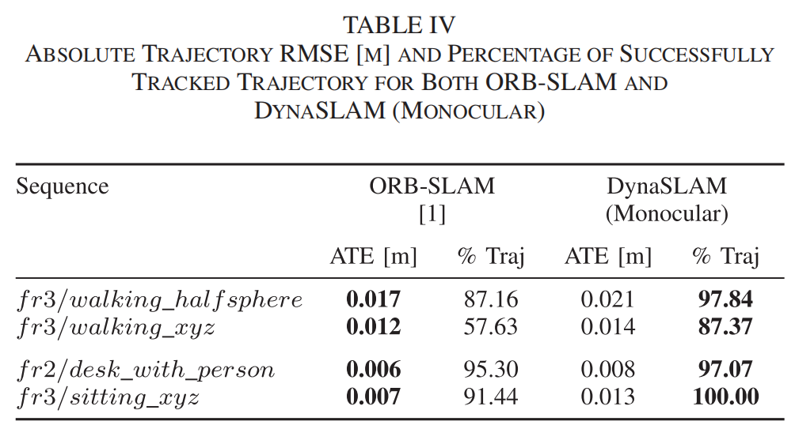
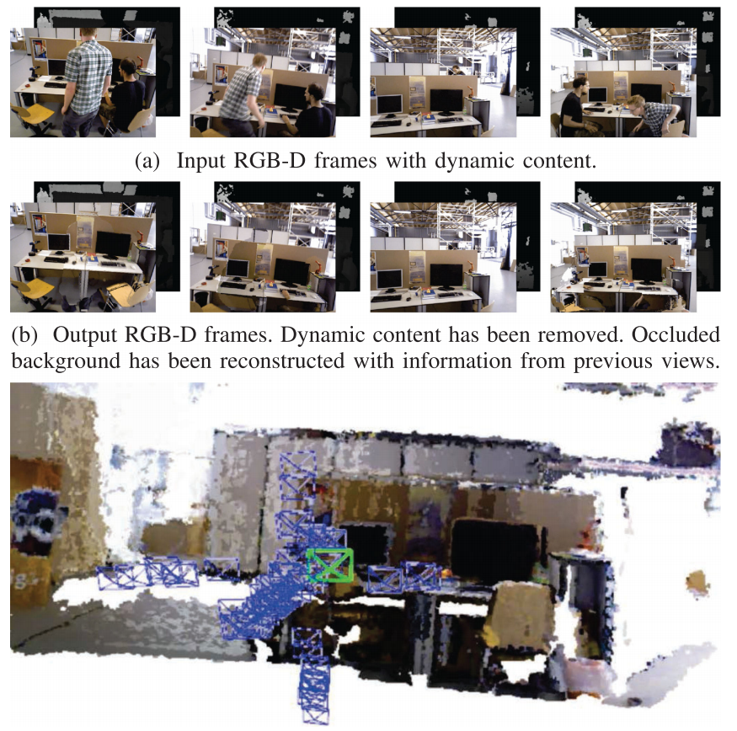
Experiments
Compare with ORB-SLAM
尽管DynaSLAM的精度略低，但它成功地引导了具有动态内容的系统，并生成了没有这些内容的地图，可用于长期应用。DynaSLAM精度略低的原因是估计的轨迹较长，因此存在累积误差的空间。
Notes:
Descartes was a French philosopher, scientist, and mathematician, widely considered a seminal figure in the emergence of modern philosophy and science.
Descartes has often been called the father of modern philosophy, and is largely seen as responsible for the increased attention given to epistemology in the 17th century.He laid the foundation for 17th-century continental rationalism, later advocated by Spinoza and Leibniz, and was later opposed by the empiricist school of thought consisting of Hobbes, Locke, Berkeley, and Hume.
Descartes' influence in mathematics is equally apparent; the Cartesian coordinate system was named after him. He is credited as the father of analytic geometry—used in the discovery of infinitesimal calculus and analysis. Descartes was also one of the key figures in the Scientific Revolution.

Slide 14
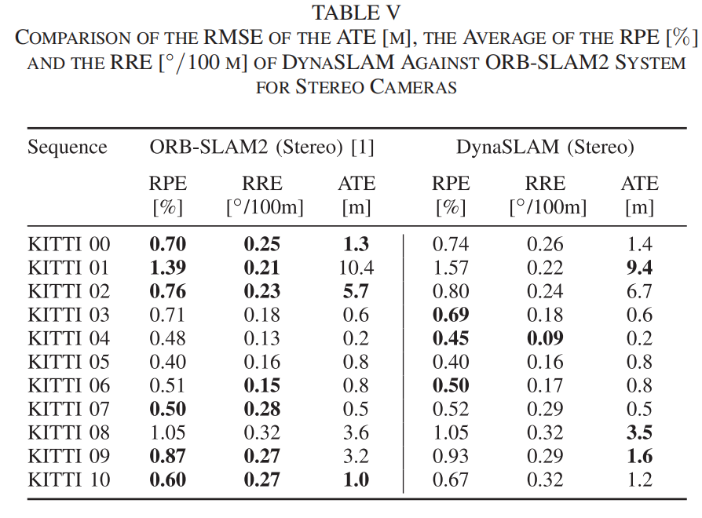
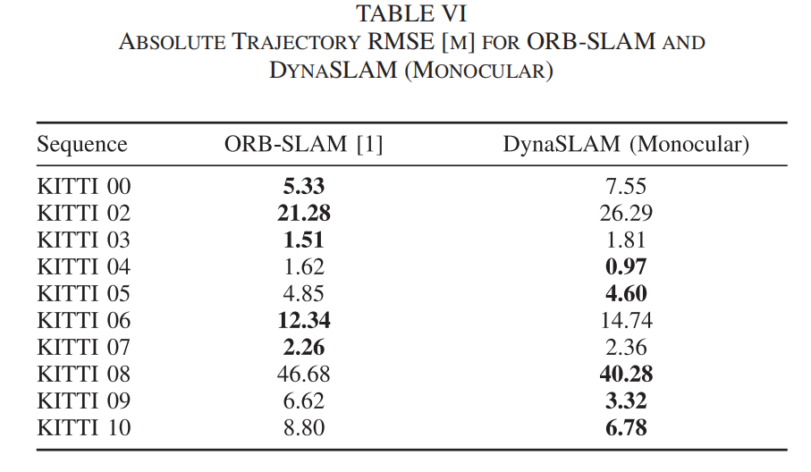
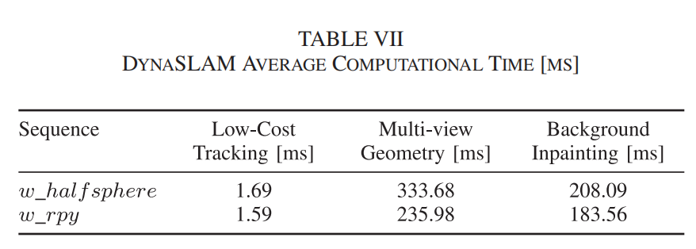
Experiments
KITTI Database and Timing Analysis
存在未知先验物体
Notes:
Descartes was a French philosopher, scientist, and mathematician, widely considered a seminal figure in the emergence of modern philosophy and science.
Descartes has often been called the father of modern philosophy, and is largely seen as responsible for the increased attention given to epistemology in the 17th century.He laid the foundation for 17th-century continental rationalism, later advocated by Spinoza and Leibniz, and was later opposed by the empiricist school of thought consisting of Hobbes, Locke, Berkeley, and Hume.
Descartes' influence in mathematics is equally apparent; the Cartesian coordinate system was named after him. He is credited as the father of analytic geometry—used in the discovery of infinitesimal calculus and analysis. Descartes was also one of the key figures in the Scientific Revolution.

Slide 15
Conclusion
结论及局限性
结论：最大创新点是图像修补，对于长期导航、人机交互、增强现实、回环检测、重定位等方面都有很积极的作用
可以学习借鉴的地方：
1. 使用了Mask R-CNN+多视图几何的方法进行动态物体去除，这两种方法进行互补，对于几何方法，主要问题是初始化并不简单，因为它具有多视图的性质，但它可以解决长期地图中半静态物体问题。学习方法不存在这样的初始化问题，但它们无法识别半静态物体。
2. 我觉得这篇文章的亮点还是在图像修复模块，在他们提供的视频中可以看到，这个修补效果确实很好，这个算法放到增强现实应用中应该很不错。
3. 它的图像修复部分，对回环检测或者长期导航有很大帮助。
Notes:
Descartes was a French philosopher, scientist, and mathematician, widely considered a seminal figure in the emergence of modern philosophy and science.
Descartes has often been called the father of modern philosophy, and is largely seen as responsible for the increased attention given to epistemology in the 17th century.He laid the foundation for 17th-century continental rationalism, later advocated by Spinoza and Leibniz, and was later opposed by the empiricist school of thought consisting of Hobbes, Locke, Berkeley, and Hume.
Descartes' influence in mathematics is equally apparent; the Cartesian coordinate system was named after him. He is credited as the father of analytic geometry—used in the discovery of infinitesimal calculus and analysis. Descartes was also one of the key figures in the Scientific Revolution.

Slide 16
Video

Slide 17
Thanks For Listening
Class ：0717
Group：1
Data ：2023.10.23

